Slide 1


Learn Chinese，learn China
Notes:
If you want to have a deeper understanding about the culture of a country , you may need to learn the language of that country. At least, the language of Chinese contain plenty of Chinese culture. So I hope every one of you, not only just learn to speak Chinese, but through Chinese, you know more about china. Yet all in all, Chinese may be an imperative tool in your daily life since you may stay in Beijing for a few months.
<number>

Slide 2
生活汉语
Daily Chinese

Slide 3
self-introduction
Wáng Yàn
王 艳
family name
first name
Notes:
Ok, now I’d like to introduce myself. My name is Wang Yan. In Chinese, we put our family name the first and first name follows. Most of the family names are only one Chinese character, but two-character family name is also common. And most of the first names are also one or two characters.
In terms of the Chinese name, there are many stories to be told, if we have time, we may refer to some in our class.
You may see the roman letters on the Chinese characters. They are called pinyin, just like phonetic sign to English words. We use pinyin to help us pronounce the Chinese characters. Therefore, what we need to learn first, is pinyin. And maybe this is the part you may feel the most familiar.
<number>

Slide 4



Contact
Phone: 18612036446
Email: 362524559@qq.com
WeChat：18612036446
Notes:
If you have any problem, please don’t hesitate to connect me.
<number>

Slide 5



Reference
Notes:
Here are references for you. Actually I designed the course mainly by these three books. So if you want to learn more, you can borrow it from library. But if you don’t have time, it’s ok. The ppt is enough for you. And there are also many videos online, you can select some. And usually audio-visual materials may impress you more than written materials, according to my own experience.
<number>

Slide 6
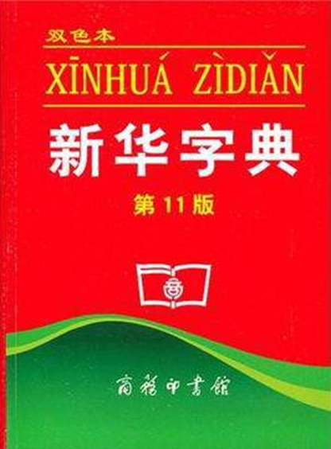
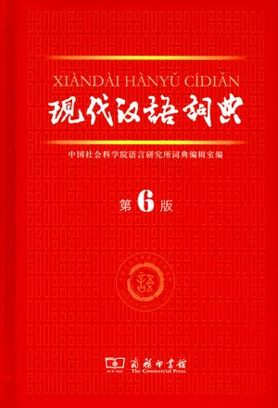

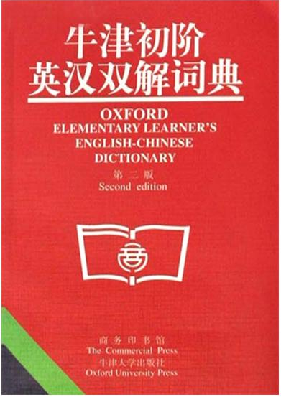

Dictionary
Notes:
In terms of dictionaries, just as a recommendation. May be you don’t need them. These two red dictionaries on the left are the most widespread in china. Nearly every Chinese teenagers used it when they in their primary and secondary school. When you know some basic Chinese, you may find it useful. The dictionaries on the right are English-Chinese and Chinese-English dictionaries. The most classic two. But all in all, you may just use google translate the most time. What I need to mention is that, google translate is not always reliable.
<number>

Slide 7
Examination
Roll call 16%
1. Regular performance：30%
2. Midterm exam：20%
3. Final exam：50%
Presentation 14%
Final Mark
Notes:
The final mark includes three parts, Regular performance, , It occupied 30%; it includes two parts
and Midterm exam, it occupied 20%; and the final exam, it occupied50%.
<number>

Slide 8
Schedule
Basic Pronunciation
Lesson 1 Hello
Lesson 2 Make a phone call
Lesson 3 What would you like to eat?
Lesson 4 How much is it?
Lesson 5 What shall we take?
Lesson 6 I want to rent a house
Review & Midterm exam (Lesson 1 -Lesson 6 )
Notes:
Here comes the schedule. This is only what I conceived. I will adjust them according to your condition. I may add more things if you think it too easy. What I need to mention is that we have 2 review lessons altogether. And there are 1 midterm exam and the final test.
<number>

Slide 9
Lesson 7 He is sick
Lesson 8 I am going to the bank
Lesson 9 Come to my house this weekend
Lesson 10 I bought a new mobile phone
Lesson 11 I surf the internet everyday
Lesson 12 How is your weekend
Final Review (Lesson 1 -Lesson 12 )
Final Exam
Notes:
<number>

Slide 10
Number | Group name | Member name
1
2
3
4
5
Notes:
XX students set up a team by yourself , and give a name of your group.
<number>

Slide 11
基础语音 Basic Pronunciation
1.声母 Initials
2.韵母 Finals
3.声调 Tones
4.声调位置 Tone position
5.声母+韵母 The Combination of Initials and Finals
6.轻声 Natural tones
7.变调 Modulation of Tones
Notes:
<number>

Slide 12
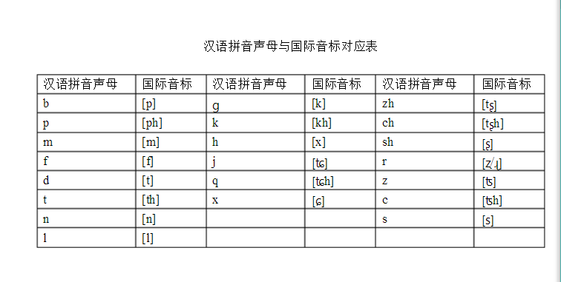
1.声母 Initials（21）
Notes:
<number>

Slide 13
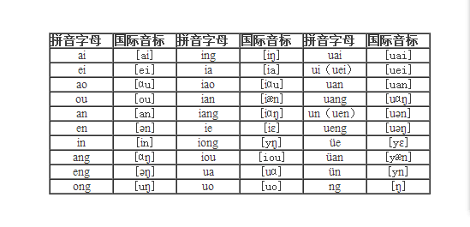
2.韵母 Finals（36）
a [Ą] o[o] e [ɣ] i[i] u[u] ü[y]
Notes:
单韵母simple finals（6）and other 30 finals
<number>

Slide 14
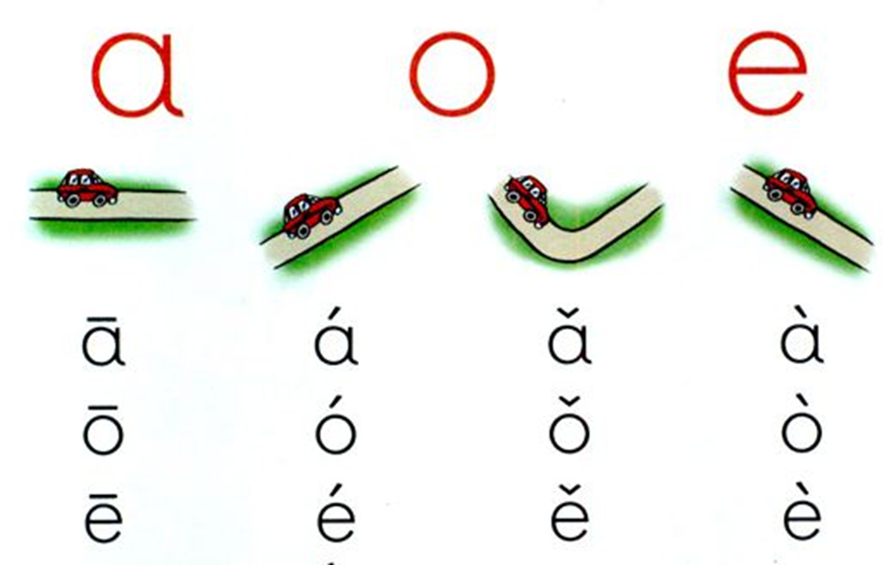
3.声调 Tones
Notes:
To thousands of Chinese characters, only these initials and finals is not enough. Here comes the most challenge part of Chinese sound system: tones. Each syllable in Chinese has as many as four different tones. The first tone is a high-pitched level tone and is represented by a horizontal bar over the vowel letter or the most salient(突出的) vowel letter in a syllable. The second tone is a rising tone, and its tone mark is a rightward up-going line. The third tone is a dipping(落下的，蘸，浸渍) tone. It starts low and goes even lower before going up. The third tone is indicated by a small tick. The fourth tone is a falling tone, and its tone mark is a short line going downward to the right.
(注：1.游戏练习：用双臂展示四种声调；
2.先学习一声和三声；再学习二声和四声
<number>

Slide 15
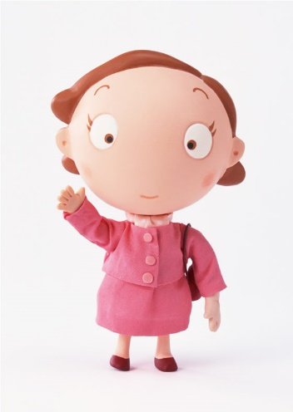
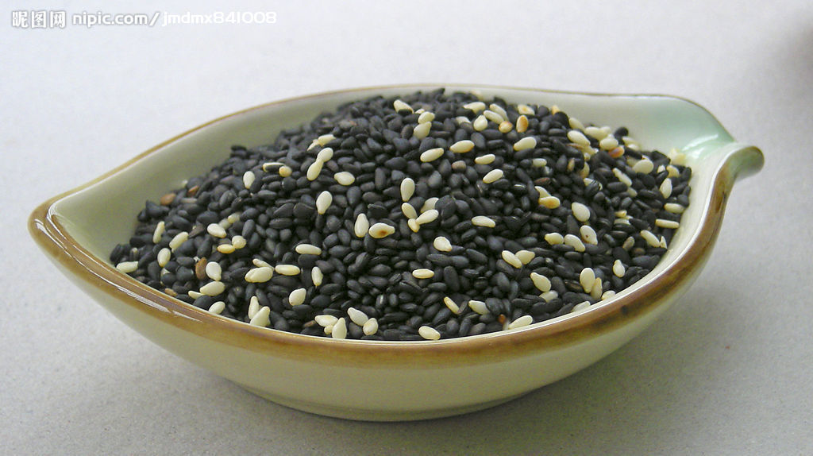

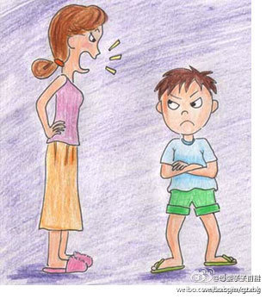
声调 Tones
mā
mother
má
sesame
mǎ
horse
mà
scold
Notes:
声调不同，意思就不一样。
When a syllable is pronounced in different tones, it has different meanings.
<number>

Slide 16
4.声调位置 Tone position
How to write the tone’s mark
1.If there’s “a” , put it on “a”.
2.If there’s no “a”, put it on “o” or “e” instead.
3.If there are “i” and “u”, put it on the latter one.
(When a tone-mark is placed above the vowel “i”,the dot over it should be omitted)
Exercise
ba mao qia biao
wo hou duo dong
te dei zhen sheng
yi tui diu
Notes:
注：1.听老师读，学生手臂表演并进行标注
2.一个学生读并用手臂表演，另一个学生进行标注。一个回合之后轮换。
<number>

Slide 17
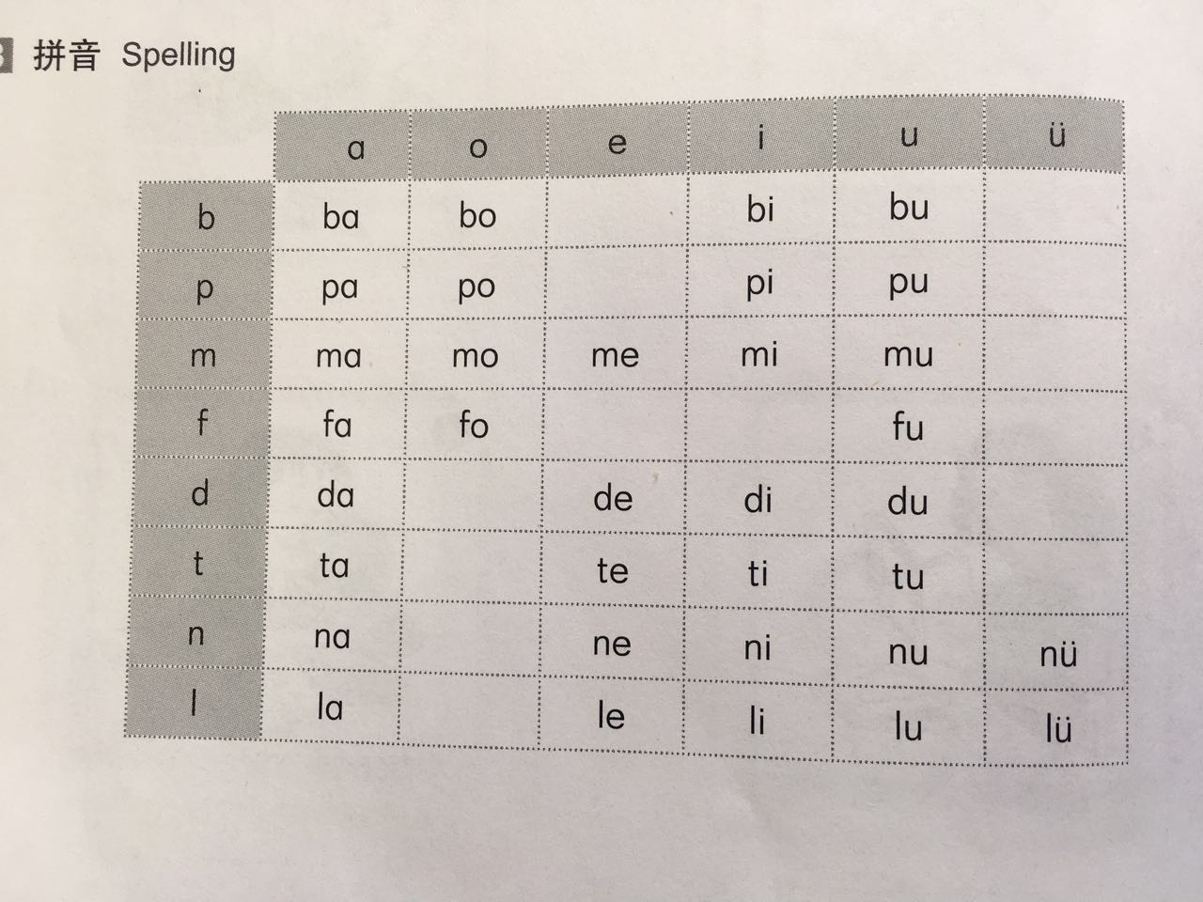
5.声母+韵母 The Combination of Initials and Finals
Initials
b p m f d t n l
Finals
a o e i u ü
er
Notes:
汉语的音节绝大多数是由声母和韵母组成。音节开头的辅音叫声母，其余部分叫韵母。A Chinese syllable is usually composed of an initial and final. The former is a consonant that begins the syllable and the latter is the rest of the syllable.
注：跟读练习
<number>

Slide 18
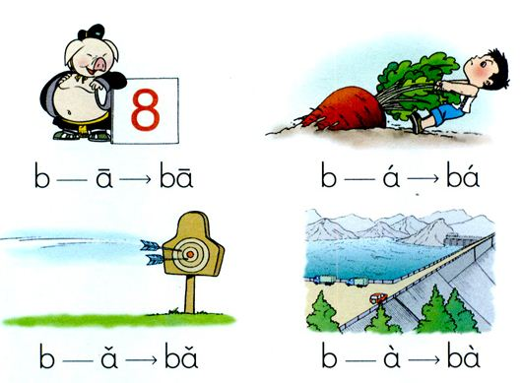
声母＋韵母 The Combination of Initials and Finals
Notes:
注：1.跟读练习,根据图示稍加讲解
<number>

Slide 19
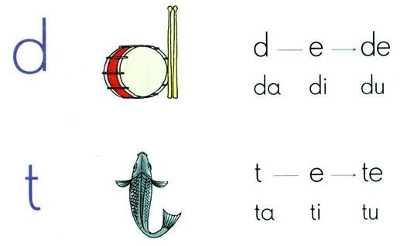
声母+韵母 The Combination of Initials and Finals
Notes:
<number>

Slide 20
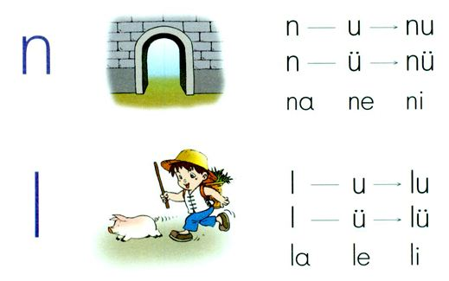
声母+韵母 The Combination of Initials and Finals
Notes:
<number>

Slide 21
6.轻声 Natural tones
māma bàba yéye nǎinai
shénme wǒmen xìexie
hǎode yǐzi yīfu
Notes:
Do you know what is Natural tones? It means the pinyin of this Chinese don’t have the tones, Like this. The Natural tones don’t appear at the first character of the word. It often appears at the second character. The natural tones is very easy to learn, they are pronounced soft and short.But it don’t have the rules to decide which is the natural ,which is not the natural tone. So, you had to spend time to remember these words. Ok?
<number>

Slide 22
7.变调 Modulation of Tones
1. v＋v → ⁄ ＋v
Nǐhǎo → níhǎo lǎohǔ → láohǔ
Notes:
1.两个第三声的音节连在一起时，前一个要读成第二声。A third tone, when immediately followed by another third tone, should be pronounced in the second tone .
<number>

Slide 23
变调 Modulation of Tones
2. 儿化（Retroflex-syllable）
nǎ er → nǎr zhè er → zhèr xiǎo hái er→ xiǎoháir
哪儿 这儿 小 孩 儿
Where here child
Notes:
er常常跟其他韵母结合在一起，使该韵母成为儿化韵母。儿化韵母的写法是在原韵母之后加
-.r The final “er” is usually attached to another final to form a retroflex-syllable and when thus used, it is no longer an independent syllable. A retroflex-syllable is represented by the letter “r” added to the final.
<number>

Slide 24
Phonetic drills
辨声母Initial discrimination
(1)bā –pā (2)dè-tè (3)nǐ-lǐ
(4)mó-fó (5)bù-pù (6)má-fá
(7)nǔ- lǔ (8)dú-tú (9)bǐ-pǐ
辨韵母 Final discrimination
mā-mē (2)bǎ-bǒ (3)fó-fá
(4)pì-pù (5)tà-tè (6)lǐ-lǚ
(7)dà-dì (8)mǒ-mǔ (9)nǚ-nǔ
Notes:
1.辨声母：老师读学生举手，----一个学生读另一个学生举手，轮换。
2.辨韵母：老师读学生举手，----一个学生读另一个学生举手，轮换
<number>

Slide 25
Phonetic drills
辨调Tone discrimination
(1)bǐ –bì (2)mō-mò (3)pà-pā
(4)tǔ-tū (5)nù-nǔ (6)lū-lù
(7)dé- dè (8)fū-fú
Notes:
1.辨声母：老师读学生举手，----一个学生读另一个学生举手，轮换。
2.辨韵母：老师读学生举手，----一个学生读另一个学生举手，轮换
<number>

Slide 26

Dictation Listen to the recording, and the fill in the blanks
（1） ___ā （2）___ǚ （3）___ù
（4） ___ó （5） ___ì （6） ___é
（7） ___ǐ ___ì （8） ___ī ___ò （9） ___ú __ ù
（10） ___ǔ ___ì （11） ___è ___ì （12） ___ǔ ___ì
（13） n ___ （14）f ___ （15） p ___
（16） l ___ （17）d ___ （18） m ___
（19） p___ b ___ （20） d ___ g ___ （21） t ___y ___
（22） n ___ p ___ （23）d ___y ___ （24）b ___ l ___
Notes:
<number>

Slide 27
小结 Summary
1.声母 Initials：b p m f d t n l
2.韵母 Finals：a o e i u ü er
3.声母+韵母 The Combination of Initials and Finals
4.声调 Tones — / ∨ ﹨
5.声调位置 Tone position
6.轻声 Natural tones
7.变调 Modulation of Tones
Notes:
<number>

Slide 28
作业 Homework
1.Please review the pronunciation of the blow initials and finals :
Initials
b p m f d t n l
Finals
a o e i u ü
er
Notes:
<number>

Slide 29
THANK
YOU

